Slide 1
Project Two
Attrition Analysis
By Kayla Sacks

Slide 2

Concerns of Attrition
With the rapid growth of the company, there has also been an increase in attrition. Due to this there has been a request find what conditions could be causing attrition to worsen.
To determine the cause of the problem, the HR Attrition database was utilized to find possible connections or patterns between several variables to find the answer.

Slide 3
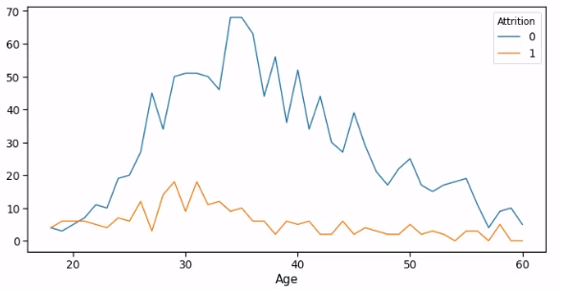
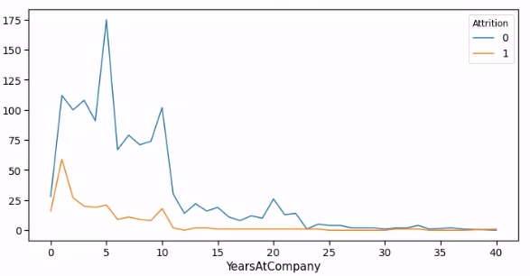
Non-Impactful Factors
There are many factors that have been considered that can impact attrition, but many have been found to have little to no impact on it.
These two charts show that age and years at the company do not have much significance to why employees are quitting.

Slide 4
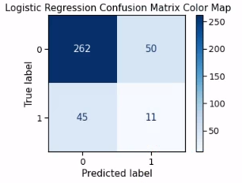
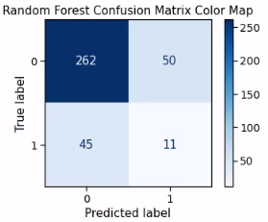
Impactful Features
With 34 different variables that could affect attrition, 5 were found to have a significant effect which are listed from most impactful to least:
Performance Rating
Work Life Balance
Job Satisfaction
Years with Current Manager
Over Time
The significance of these variables is shown though the models created.
Logistic Regression Model Accuracy: 100%
Random Forest Model Accuracy: 74.2%

Slide 5
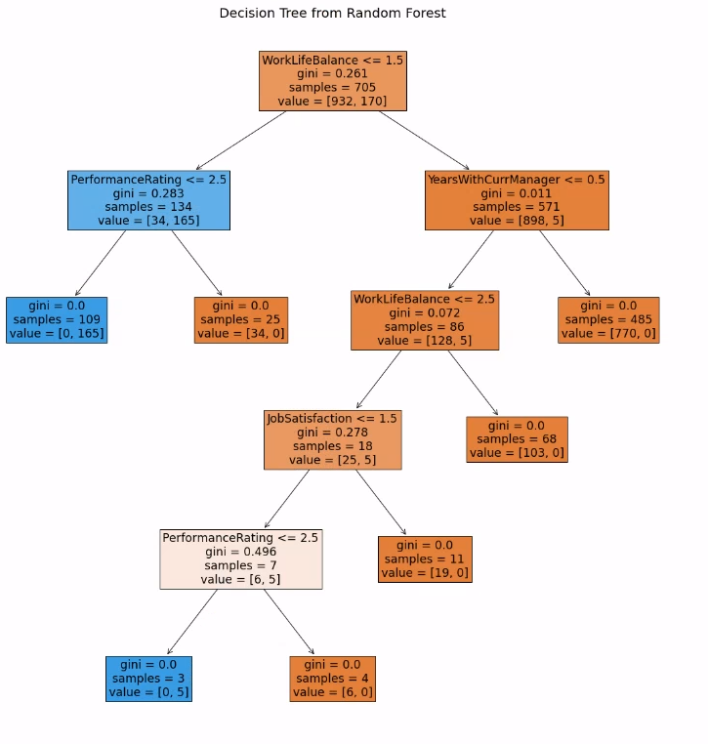
Results
From the analysis we have learned that there are 5 variables that have the most impact on why our employees are choosing to leave.
Based on this outcome, these are my suggestions to for each of the important variables.
Performance Rating
Provide additional training and constructive feedback to employees
Work Life Balance
Provide different work schedules that could fit employee life schedules
Job Satisfaction
Improve the work environment and provide encouragement and benefits to employees
Years with Current Manager
Provide benefits to managers that have few to no complaints from their team members and whose teams show continued improvement, good performance, and low turnover
Over Time
Investigate what is requiring employees to work overtime and find ways to respond

